Slide 2
Fine Grained Mesh
Metrics for Better Visibility with Native Performance
{kuat,gargnupur,mjog}@google.com
Notes:
Thursday, November 21 • 4:25pm - 5:00pm
Knowing granular traffic patterns is crucial in understanding the functioning and health of a service mesh. The existing Envoy extensions collecting metrics are either not granular enough or can consume too many resources.
In this session, attendees will learn about an efficient way of producing granular metrics. This method introduces a new metadata exchange protocol between peer workloads and uses the new Envoy/WASM metrics API to produce richly dimensioned metrics based on the exchanged metadata.
The operator can add arbitrary peer dimensions like availability zones and locality to get additional insights into the traffic. Istio will use this technique to efficiently produce highly dimensioned Istio standard telemetry.
Attendees will see a demo of rich telemetry collection to Prometheus at near native performance.

Slide 3
Outline
Why ?
What ?
How ?
Evaluation
Notes:
why/problem: need fine-grained telemetry for service meshes
what: Envoy WASM-based filters for producing prometheus metrics directly in the proxy
problem with default envoy metrics (extensibility, granularity, reliance on the controlplane)
how:
generic WASM filter framework for configurability
metadata exchange filter
HTTP + node metadata first
TCP per-connection, ALPN, TLS
stats filter
associated computed properties with measurements
WASM runtime / ABI
evaluation: performance overhead, scale tests

Slide 4
Envoy basic stats
Inter sidecar telemetry is a cornerstone of a service mesh.
who is calling whom?
Envoy native stats
Cluster Stats: client side view; but not very configurable.
upstream_rq{response_code_class="2xx",cluster_name="outbound|8080||svc00-0-1.service-graph00.svc.cluster.local"} 116987
Can rely on cluster naming convention to encode additional information.
Downstream Stats: server side view. Missing source information. Envoy does not know who sent the request beyond source IP.
Notes:
1. Moving from a monolith to a mesh means we really want to know what is happening on the network links.
2. Who is calling whom is the obvious question that everyone will want to ask...
3. Give examples of granularity. workload - workload (k8s deployment / k8s deployment), workload instance etc.
3. The dynamic granularity:
Switch from workload-to-workload to instance-to-instance.
B. Envoy stats: performant, but rigid.

Slide 5

Envoy Stats
Very fast.
Purpose built
.
Only turns left
Notes:
https://pixabay.com/photos/auto-racing-nascar-car-sport-583517/

Slide 6

Envoy Stats Wishlist
Peer aware - Metric dimensions based on Peer.
Configurable - Metric dimensions based on traffic.
Control plane agnostic.
Performant
Notes:
https://pixabay.com/photos/car-racing-barcelona-formula-1-1404060/

Slide 7
Peer Aware - HTTP Header exchange
Simplest exchange protocol
Fully stateless
Inefficient ? In most cases exchanging the same metadata over and over.
Notes:
https://snapshot.raintank.io/dashboard/snapshot/pRuXZcLgLzahyFkg0cs9700gkrukFWPQ

Slide 8
Peer-to-Peer Metadata Exchange
Client Envoy sidecar
Server Envoy sidecar
{
POD_NAME: *,
NAMESPACE: *,
LABELS: *
}
{
POD_NAME: *,
NAMESPACE: *,
LABELS: *
}
Notes:
Basic principle:
proxy starts with a metadata in its bootstrap
proxy sends the metadata to peer proxies
proxy receives the metadata from peer proxies
Requires designator:
outbound/inbound
Benefits:
self-sufficient, does not require Control Plane coordination

Slide 9
HTTP Exchange
GET / HTTP/1.1
Host: …
X-Peer-Metadata: <base-64 protobuf message>
X-Peer-Metadata-Id: <string id>
...
HTTP/1.1 200 OK
X-Peer-Metadata: <base-64 protobuf message>
X-Peer-Metadata-Id: <string id>

Slide 10
HTTP Exchange (cont.)
Performance optimizations:
HTTP/2 upgrade between sidecars for binary encoding
HTTP/2 METADATA frames (type=0x4D), per-stream and per-connection (limited proxy support)
HTTP tunnelling (HTTP CONNECT method)
gRPC tunnelling (bi-di tunnel stream)
Caching and side-lookups: split KEY vs PAYLOAD, exchange keys only between extensions and maintain caches from KEY->PAYLOAD

Slide 11
TCP Exchange w/prior knowledge
...
Metadata
BinHeader
Client sidecar
Server sidecar
TCP upstream extension
TCP downstream extension
TCP stream
BinHeader
Metadata
...
Source of prior knowledge:
control-plane supplies EDS metadata bit indicating presence of Envoy sidecar on the other side
peer-to-peer negotiated using TLS extensions
Notes:
Mention EDS for prior knowledge
Prefix-based exchange
Proxies block until receiving the expected prefix before sending the rest of the data
Headers is magic number + length

Slide 12
TCP Exchange w/ ALPN
TLS Client Hello(Alpn with Istio2 as supported protocol)
Client sidecar
Server sidecar
TLS Server Hello(Alpn with Istio2 as selected protocol)
TCP upstream extension
(verifies ALPN)
TCP downstream extension
(verifies ALPN)
...
Metadata
MetadataExchangeInitialHeader
TCP stream
MetadataExchangeInitialHeader
Metadata
...
MetadataExchange Initial Header Format
+---------------------------------------------------------------+
Magic(32)
+---------------------------------------------------------------+
DataSize(32)
Notes:
Mention EDS for prior knowledge
Prefix-based exchange
Headers is magic number + length(Datasize)
Metadata is (Google Any) (0...DataSize)
magic_number = 0x3D230467; // decimal 1025705063

Slide 13
Stats extension using Wasm API
// Allocate a dimensioned stats metric
Metric requests_total(MetricType::Counter,
{{“source_workload”,TagType::String},
{“destination_service”, TagType::String}, ...});
// Populate dimension labels computed from node metadata
vector<string> values = {“pod-1ac5e”, “ratings”, …};
// Resolve a stats metric ID
auto metric_id = requests_total.resolveWithFields(values);
// Emit value
recordMetric(metric_id, 1)

Slide 14
Internal Envoy Wasm context API
auto bytes = getProperty({
“filter_state”,
“envoy.wasm.metadata_exchange.upstream”})
Envoy in-process
request context
upstream metadata | <proto bytes>
downstream metadata | <proto bytes>
node metadata | <proto bytes>
request. headers | string map
Metadata exchange Wasm/C++ extension
Stats
Wasm/C++ extension
Notes:
use ABI to save and exchange blobs of data
format is known to extensions, raw bytes for performance

Slide 15
Stats extension (cont.)
Gotchas:
Envoy stats subsystem is statsd-style and linearizes all dimensions into a single string:
requires parsing and rewriting on export
Envoy stats are hierarchically scoped to xDS resources, which does not map well to Wasm VMs lifecycles
lame duck stats scope for draining listeners

Slide 16
xDS configuration
Activated in Istio using xDS patching configuration a.k.a EnvoyFilter:
apiVersion: networking.istio.io/v1alpha3
kind: EnvoyFilter
metadata:
name: metadata-exchange
spec:
configPatches:
- applyTo: HTTP_FILTER
match:
context: ANY # inbound, outbound, and gateway
listener:
filterChain:
filter:
name: "envoy.http_connection_manager"
patch:
operation: INSERT_BEFORE
value:
name: envoy.filters.http.wasm
config:
config:
vm_config:
runtime: envoy.wasm.runtime.null
code: { inline_string: envoy.wasm.metadata_exchange }

Slide 17
Evolution of Istio telemetry
Envoy
Mixer extension
Istio telemetry
Stats extension
Prometheus
Envoy
Mixer extension
Istio telemetry
Stats extension
Envoy
Mixer extension
Istio telemetry
Stats extension
Envoy
Istio extension
Istio telemetry
Stats extension
Envoy
Stats extension
Envoy
Stats extension
Envoy
Stats extension
Envoy
Stats extension

Slide 18
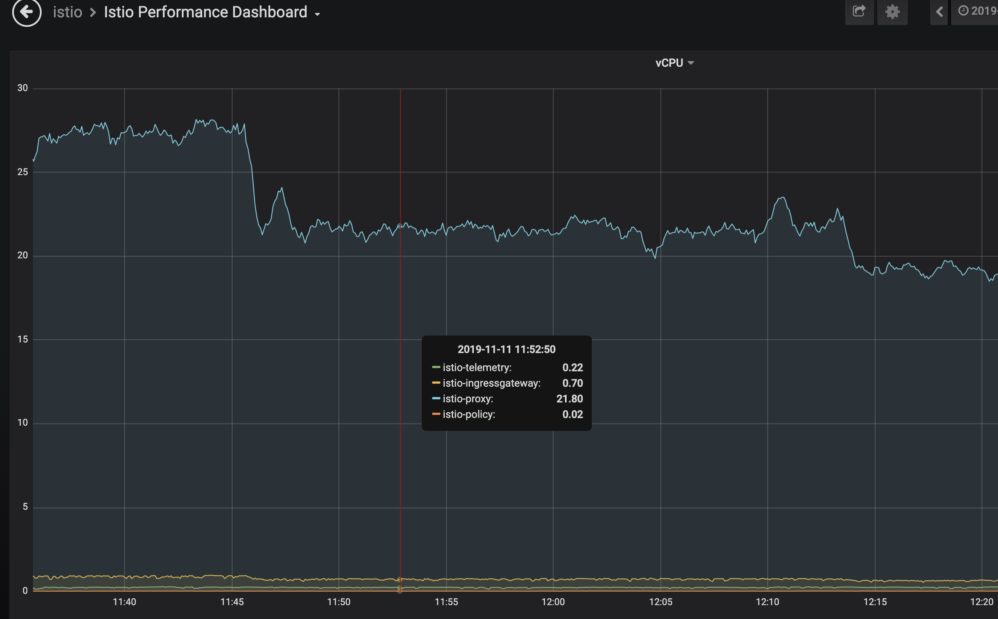
vCPU Performance
Notes:
Constant experiment
V1 Mixer: 31 vcpu
V2 Stats + stackdriver + MX: 27 vcpu
V2 Stats + MX: 25 vcpu
V2 MX only: 22 vcpu
No filter: 19 vcpu
performance relative to v1 -- savings in vCPU
incremental performance with MX/stats/sd filters for HTTP and TCP
With Mixer = 31 vcpu
need latency
need memory

